Slide 1

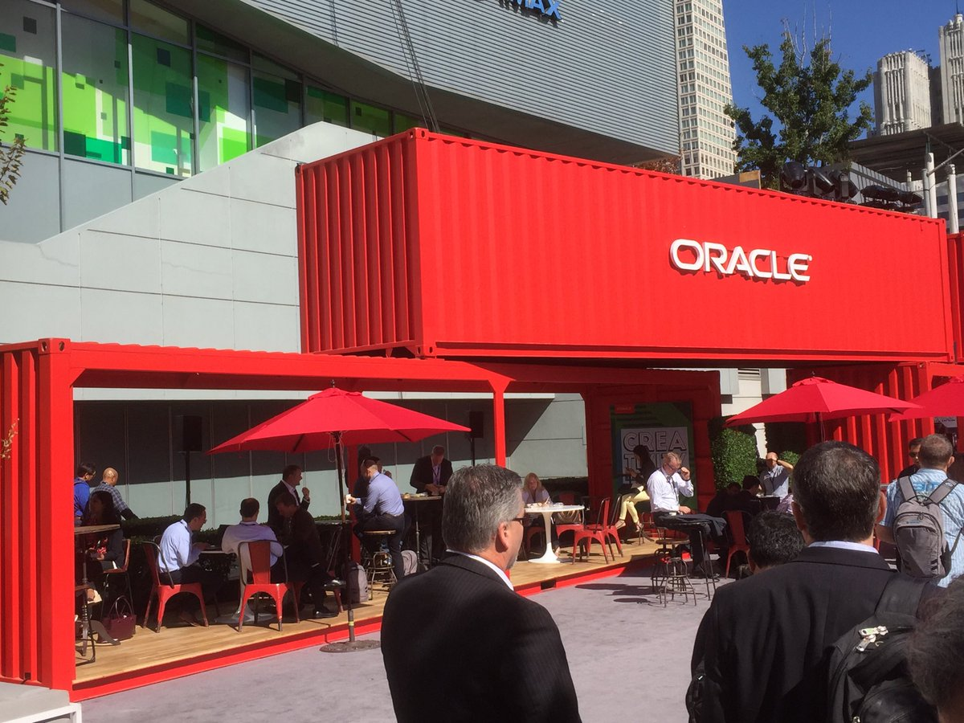

Introduction to the Oracle Cloud Microservices Platform open, manageable, polyglot and scalable
On what would be and still can be…
Lucas Jellema, CTO of AMIS
nlOUG TechExperience 2018, Amersfoort, The Netherlands

Slide 2




Microservices & SCS Architecture & Platform open, manageable, polyglot and scalable
On what would be and still can be…
Lucas Jellema, CTO of AMIS
September 2018, Arnhem, The Netherlands

Slide 3
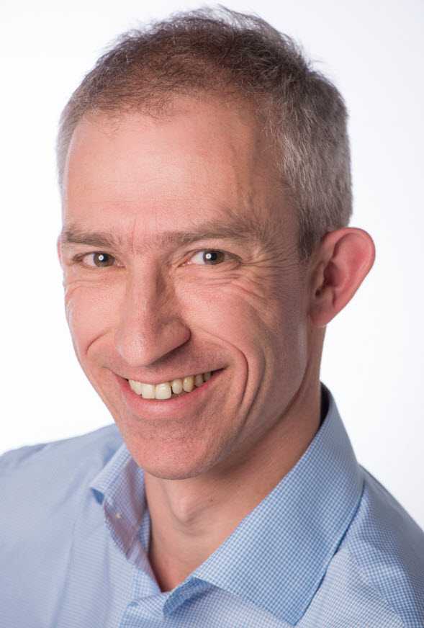
Lucas Jellema Architect / Developer 1994 started in IT at Oracle 2002 joined AMIS Currently CTO & Solution Architect

Slide 4
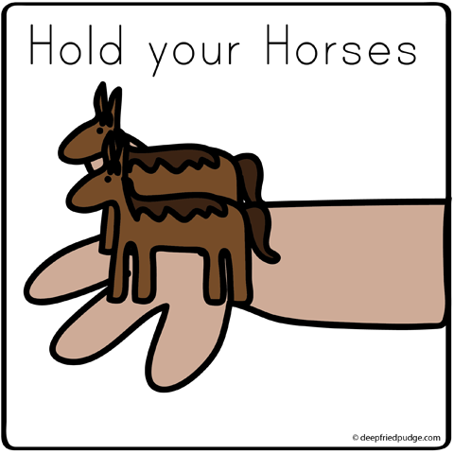
How do we implement microservices?
And how we make the containers horizontally scalable
How do we get from a Monolith to Microservices?

Slide 5
Why? What? How?
Notes:
Objectives
Requirements
Specifications

Slide 6
What is IT all about?
Production Runtime
Application

Slide 7
What is IT all about?
Production Runtime
Application
Platform

Slide 8
Objectives
Business Agility
In functionality: quick, cheap, effortless and risk free
IT Agility
In non-functionality: scale, resilience, infrastructure & location
Real working applications with rapid relevant evolution that run reliably

Slide 9
What is IT all about?
Production Runtime
Operations
Monitoring & Management
Application
Platform
Platform
Platform

Slide 10
Production Runtime is the Result of Preparation Runtime
Preparation Runtime
Production Runtime
Development
Operations
Monitoring & Management
Application
Application
Agile Design, Build, Test
Platform
Platform
CD

Slide 11
What?

Slide 12
One team has Agile responsibility through full lifecyle
Preparation Runtime
Production Runtime
Development
Operations
Monitoring & Management
Application
Application
Agile Design, Build, Test
Platform
Platform
CD

Slide 13
One team has Agile responsibility through full lifecyle
Preparation Runtime
Production Runtime
DevOps
Development
Operations
Monitoring & Management
Application
Application
Agile Design, Build, Test
Platform
Platform
CD
You build it, you run it, you fix it, you evolve

Slide 14
One team has Agile responsibility through full lifecyle
DevOps
Application
Application
Platform
Platform
You build it, you run it, you fix it, you evolve

Slide 15
DevOps team owns and runs one (or more) products
Application
Platform
Generic Infrastructure Platform for running DevOps Products
Floorspace, Power, Cooling, Storage, Compute
Monitoring, Management, Cache, Authentication, RDBMS, Event Hub

Slide 16
Multiple products from multiple teams run on a shared generic infrastructure
Application
Application
Application
Application
Application
Platform
Platform
Platform
Platform
Platform
Generic Infrastructure Platform for running DevOps Products
Floorspace, Power, Cooling, Storage, Compute
Monitoring, Management, Cache, Authentication, RDBMS, Event Hub

Slide 17
(Application plus platform)under DevOps ==
µ
µ
µ
µ
µ
Generic Infrastructure Platform for running DevOps Products
Microservice

Slide 18
What?
Realistic approach (technology, people, process) => Something that works!
No dependency on individuals
Able to scale in rate of change
Small, well: comprehensible, manageable
Clear business ownership
Stand alone /isolated/encapsulated (in terms of change, release/deploy, scale, location, implementation technology)
Provide clear and meaningful functionality in a way that it can be consumed
One microservice does not completely fall over when other microservices break (or are redeployed)
Able to scale elastically & horizontally and relocate easily
A microservice exists within a single bounded context
Multiple microservices can share the same bounded context

Slide 19
scale
own
test
monitor
deploy
organize
manage
scale
scale
own
test
monitor
own
test
monitor
organize
deploy
organize
deploy
manage
scale
manage
µ
own
test
monitor
organize
deploy
µ
µ
manage
µ
own
test
scale
vs.
scale
organize
deploy
monitor
own
test
monitor
µ
manage
own
test
scale
own
test
scale
organize
deploy
deploy
monitor
organize
deploy
monitor
µ
manage
organize
manage
µ
manage
µ
own
test
scale
organize
deploy
monitor
own
test
scale
µ
manage
organize
deploy
monitor
µ
manage

Slide 20
µ
µ
[mini] µonolith
µ
µ

Slide 21
Owned by Business Manager X
High Change Rate
Highly Available
Needs to scale up to 10x between 7-10PM
Can be done by team of 5
µ
µ
Owned by Business Manager Y
Business Hours availability
Some Highly Secure Data
Fairly constant load
Very strict QA steps in CI/CD process
Can be done by team of 3

Slide 22
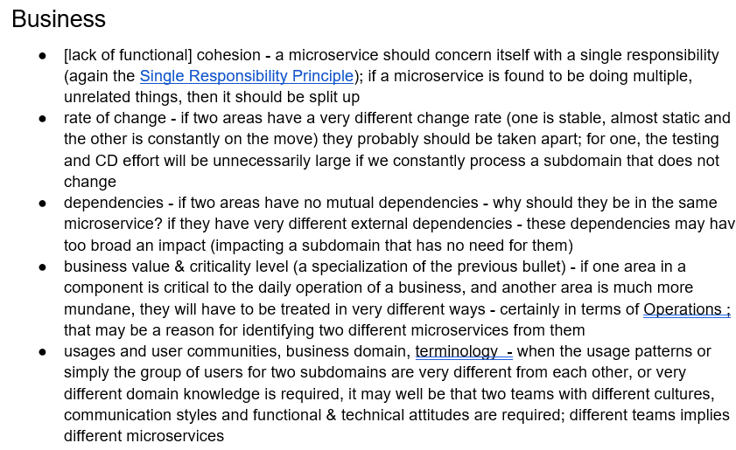
Considerations for breaking up into multiple Microservices

Slide 23
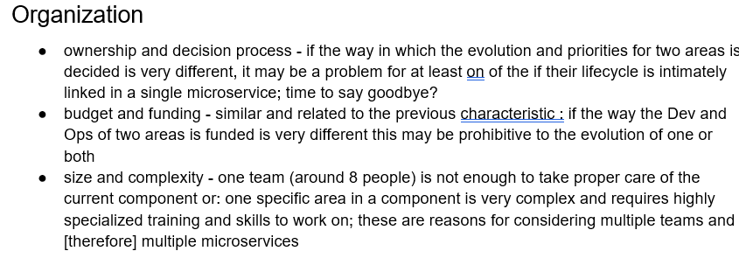
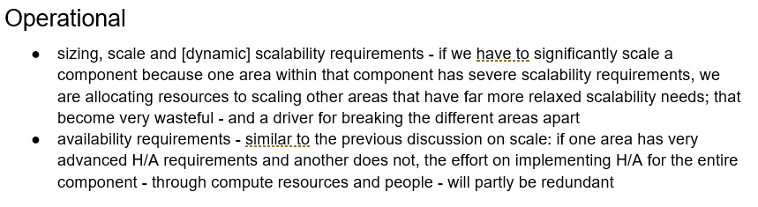
Considerations for breaking up into multiple Microservices (2)

Slide 24
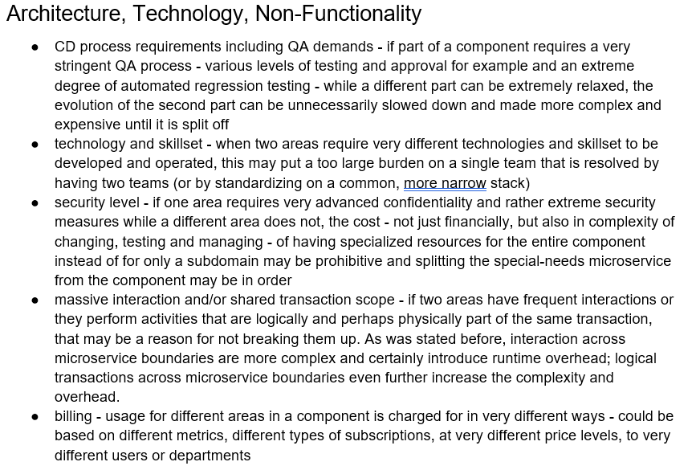
Considerations for breaking up into multiple Microservices (3)

Slide 25
How?

Slide 26
How microservices
One team owns the microservice and can do functional and technical evolution and deployment continuously and independently
The business ownership is clearly defined
Application
Platform

Slide 27
The Microservice
HTTP REST/JSON
API

Slide 28

How microservices: design & implement
Business & Team ownership of application and associated platform
Automated CD – including regression test
Open (standards, protocols) on the outside, whatever you like inside
Deployable on enterprise standardized microservices platform
API & Event
Standard protocols for interaction
Horizontally scalable: multiple parallel instances
Stateless instances – horizontally scalable up & down, can handle fail over & restart
Private Bounded (Data) Context
Including derived data from other domains

Slide 29
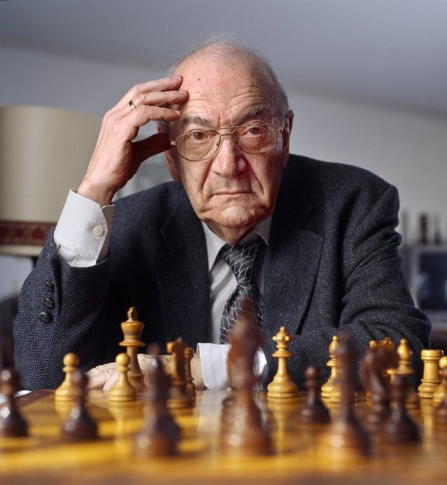
Notes:
Viktor Korchnoi – Stateless Chessplayer

Slide 30
Microservices State
Generic Platform for running microservices
LDAP
Big Data
Block Storage
Cache
RDBMS
NoSQL
Document Store
Event Hub
Notes:
All data stores are distributed
Or at least distributedly available
They can be local or on cloud (latency is important)
Data in generic data store is still owned by only one microservice – no one can touch it
Only in DWH and BigData do we deliberately take copies of data and disown them

Slide 31
Bounded context in microservices
A micoservice needs to be able to run independently
It needs to contain & own all data required to run
It cannot depend on other microservices
UI
API
Customer
API
Order
CustomerModified event

Slide 32








Demo – Maintaining Derived Data in Bounded Context
Customer Microservice
Order Microservice
Customer Modified Event
Application Container
Application Container
Event Hub
Customers
Topic
DBaaS

Slide 33

BOL - CQRS

Slide 34
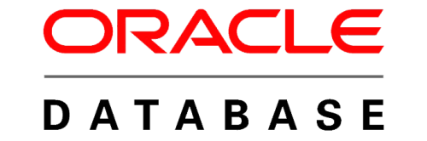
Books Online - WebShop
Products
Webshop visits
searches
product details
Orders
Product updates
Read only
On line
Speed is crucial
XHTML & JSON
> 5M visits
Data manipulation
Data Quality (enforcement)
<10K transactions
Batch jobs next to online
Speed is nice
firewall

Slide 35


Nightly generation
DMZ
Webshop visits
searches
product details
Orders
Products
Products
Products
Products
Product updates
Read only
On line
Speed is crucial
XHTML & JSON
> 1M visits
Read only
JSON documents
Images
Text Search
Scale Horizontally
Stale but consistent
Data manipulation
Data Quality (enforcement)
<10K transactions
Batch jobs next to online
Speed is nice
firewall

Slide 36
Products
Data Manipulation
Data Retrieval

Slide 37
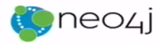



Products
Data Manipulation
Quick Product Search Index
Special Products
Data Retrieval
Toys
Product Clusters
Product Store in SaaS app
Food Stuff
Notes:
Data manipulation and retrieval in separate places
(physical data proliferation)
Query store is optimized for consumers
Level of detail, format, filters applied
For performance and scalability, independence, productivity lower license fees and lower TCO, security

Slide 38
Comand Query Responsbility Segregation = CQRS
Detect changes
Products
Extract Data
Data Manipulation
Transport Data
Convert Data
Special Products
Apply Data
Data Retrieval
Toys
Quick Product Search Index
Product Clusters
Food Stuff
Product Store in SaaS app
Notes:
No Event Sourcing
No events (?)
No green field
Packages Applications/SaaS
Databases (RDBMS, NoSQL) getting changes from applications directly
Challenges – at scale, with enough speed and consistently: do not let query store get into an exposed state that could not exist/be right!
Detect relevant changes
Extract relevant changes
Transport
Convert
Apply in correct order and reliably (no lost events)
Note: after detect and extract, an event can be published

Slide 39


From C to Q
How quickly?
How frequently?
How reliably?
How atomically?
What about consistency?
Products
Quick Product Search Index

Slide 40


Slide 41
From C to Q
How quickly?
How frequently?
How reliably?
How atomic?
When consistent?
Data Authorization Considerations
Locations & Connectivity
Full resynch | restore of Query Store
Products
Quick Product Search Index

Slide 42
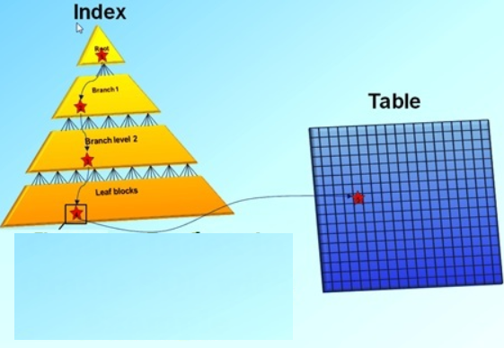
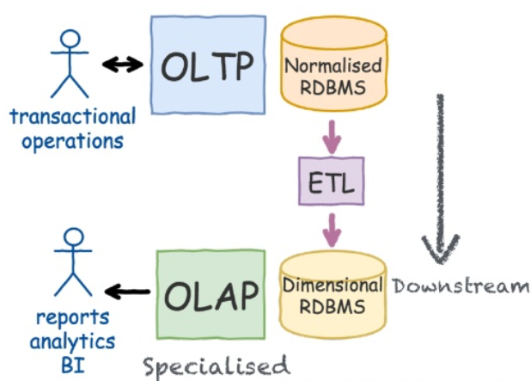
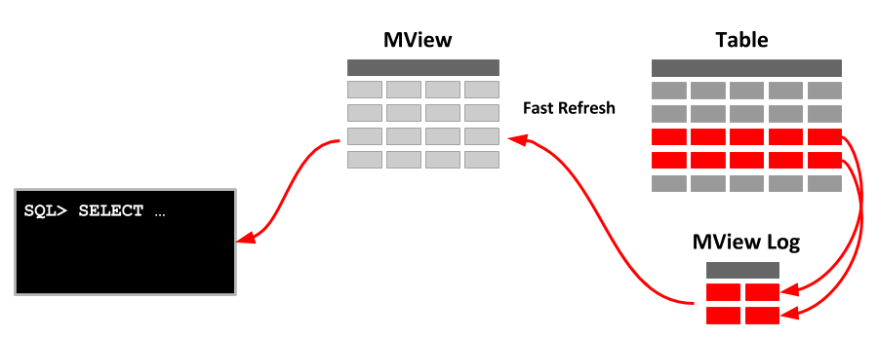
CQRS is not new
Notes:
https://www.slideshare.net/LorenzoNicora/from-c-to-q-one-event-at-the-time-event-sourcing-illustrated

Slide 43
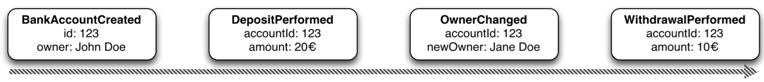
Event Sourcing Driving CQRS
amount: 10
Owner: Jane Doe
Events
Current State
Event Store
accountId: 123
Notes:
Events are immutable facts
Current state (active record) is derived from sum of events
Read optimized aggregates are created for specific use case – based on events and rebuildable at any time

Slide 44
Event Sourcing Driving CQRS
Events
Current State
Event Store
Other State Aggregate
Notes:
Events are immutable facts
Current state (active record) is derived from sum of events
Read optimized aggregates are created for specific use case – based on events and rebuildable at any time

Slide 45
Microservices based Webshop
Web Shop Portal
µ Customers
µ Orders
µ Products
µ Loyalty
µ Finance
µ Logistics
µ Customers
µ Orders
µ Products
µ Loyalty
µ Finance
Notes:
dazzle the audience with a quick dump of all technologies (and cloud services) used for putting the webshop together - for the UI, the API implementation, the datastores and the event bus.

Slide 46




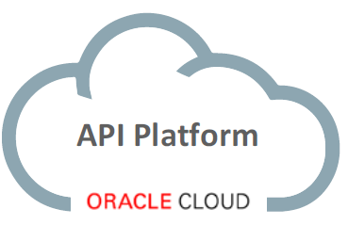



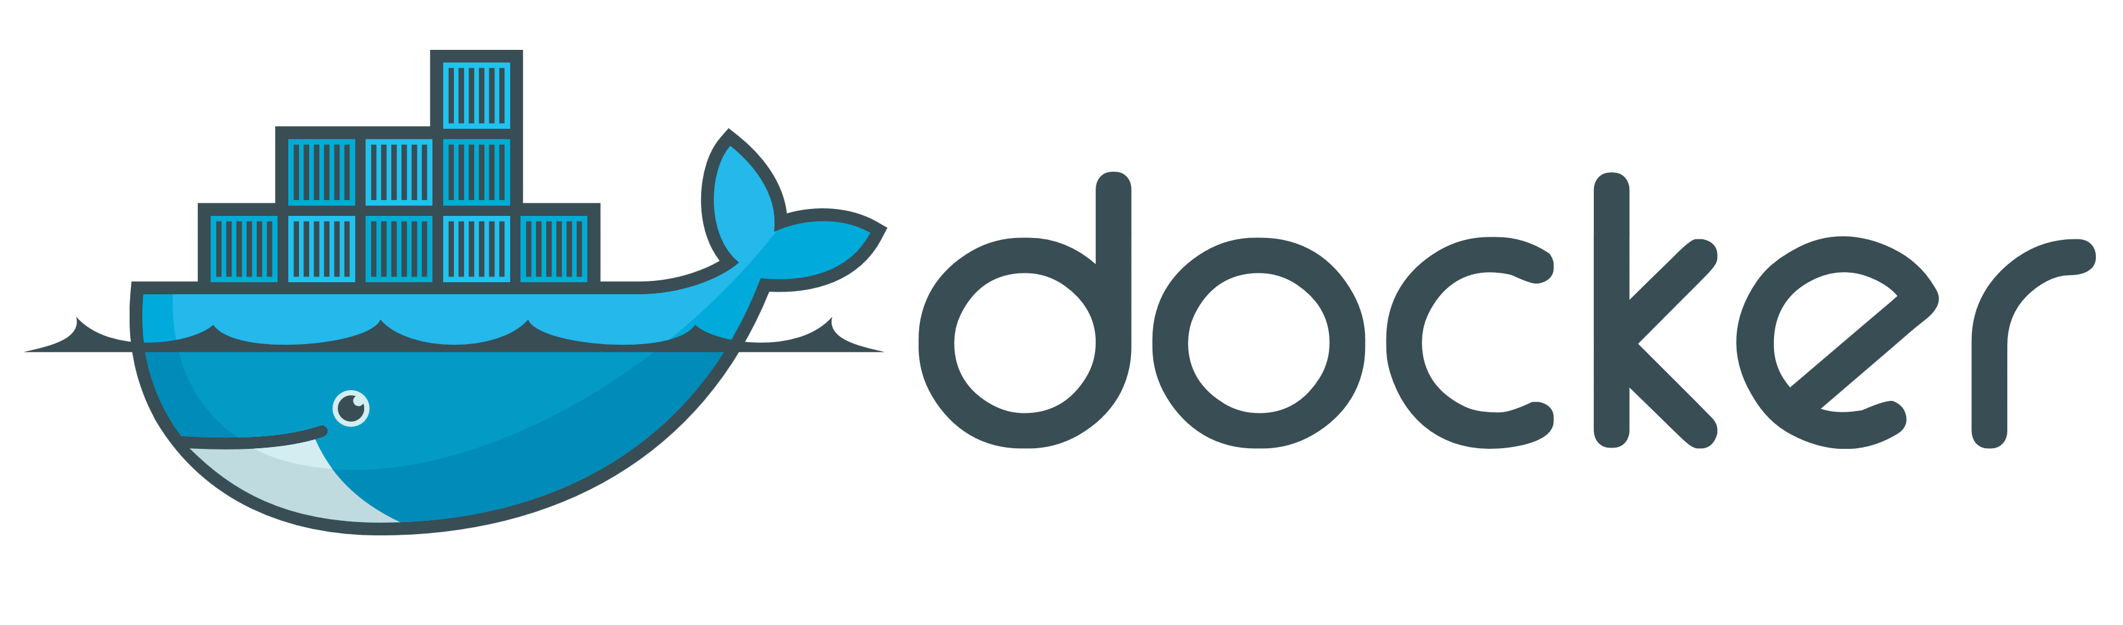
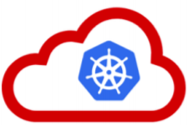






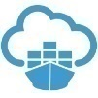



API Portal
Web Shop Portal
µ Customers
µ Orders
µ Products
µ Loyalty
µ Finance
API Platform
Backoffice UI
λ
Event Schema Registry
Event Hub
Notes:
dazzle the audience with a quick dump of all technologies (and cloud services) used for putting the webshop together - for the UI, the API implementation, the datastores and the event bus.

Slide 47
API Gateway
Many other consumers
API Portal
Web Shop Portal
µ Customers
µ Orders
µ Products
µ Loyalty
µ Finance
API Platform

Slide 48

…. Event-(First) Driven
Event Monitor
Product Update
Product added to Shopping Cart
Shop
Products
Event Hub
Topic X
Topic Y
Topic Z
Topic Q
New Customer
Customer Profile Changed
Customer Sign In
Customers
Order Payment Received
Customer Frozen
Customer Loyalty Status Change
Order Create
Order Cancelled
Product Stock Update
Shipping News
Loyalty Program
Order
Logistics
Finance

Slide 49
Events
Consumers
Producers

Slide 50
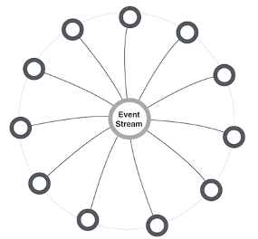
MicroServices and events
Report business events [without knowing to whom and without expecting a response]
Allowing interested microservices to respond – for example trigger serverless functions
Provide response to stateless caller – with conversation key
Choreograph cross-microservice workflow | process
Inform workflow | process orchestrator | job scheduler about activity status
Enable distributed transaction – commit and rollback/compensate
Make data events available for event sourcing
Allowing microservices to maintain their own [derived] data set
Synchronize cache refresh
Informing any microservice caching data about the need to refresh specific records
Hand systems events & metrics to monitoring service
Extreme decoupling – microservice choreography
Microservice never call each other, not even through public API; all interactions are through events
Notes:
http://microservices.io/patterns/data/event-driven-architecture.html
http://eventuate.io/whyeventdriven.html
http://www.kennybastani.com/2017/01/building-event-driven-microservices.html

Slide 51
Requirements for Event capability in microservices platform
Provide decoupling between publisher and consumer
Generally accessible for all microservices
Across the platform
Using standardized protocols and formats for communications and event payload (http, JSON)
Scalable (handle high loads)
Available (allow speedy event publication)
Reliable (do not lose events, at least once delivery)
Event Ordering (deliver events in the order of publication)
Allow multiple, parallel consumers (each event to exactly only one of them)
Retain Event History
Event Catalog – which events are published, what do they mean and what is their payload
Harvested from microservices

Slide 52
Extended API of microservice
API
Deployment API
Injectable dependencies – reference to cache, logging, storage URL, …
Configurable meta-data – run time parameters, log level, credential (key)
Interaction API
REST Resources & Operations – query and URL parameters, message formats
Events Consumed – alternative way to call | activate a microservice
Reference to entry in Event Catalog
May include reference to shared Cache Resource
Events Produced – alternative output from microservice
Event can be an asynchronous response to a stateless consumer

Slide 53
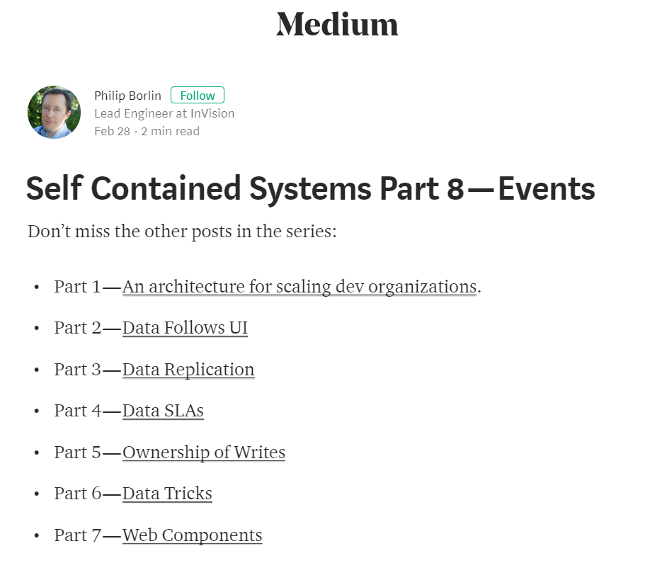
Article Series worth reading

Slide 54
Webshop split off Microservice consideration
Warehousing
µ
µ Logistics
Shipping

Slide 55
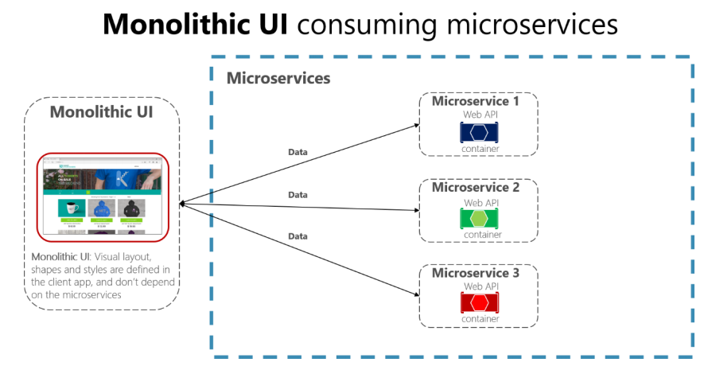
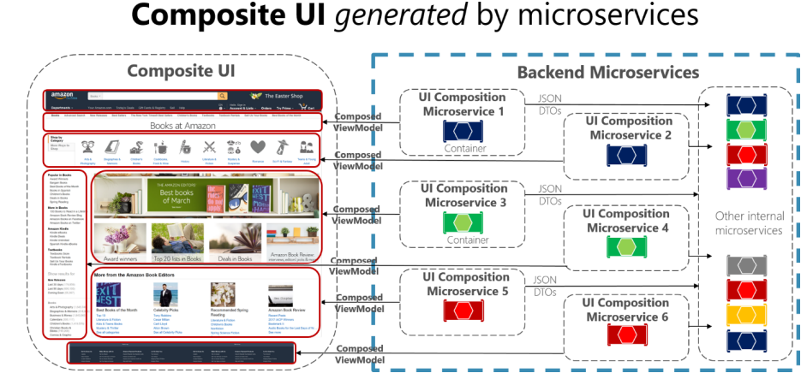
Microservices Architecture - User Interface
Is UI part of Microservice?
VS.
Notes:
spend a little time on microservices - why decided to apply a microservices architecture (objectives, expectations) and how we designed the architecture in our case (link to Omesa?). What were the rules and assumptions. Here we can perhaps show how we use Slack and GitHubExplain in some details what important role events played. Maybe at that point also discuss the workflow (@Luis Weir’s article and our discussions around that).Perhaps we can use the Event Monitor Dashboard (that shows all on EventHub/Kafka events on a timeline ) to illustrate the story on the events (and the Order workflow)

Slide 56
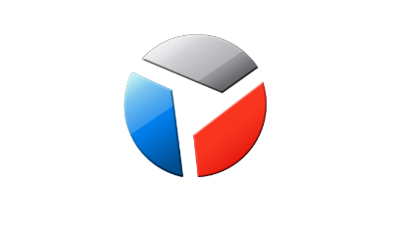
Web Shop Portal Solution Design
Web Shop – Customer User Interface
CustomerSignIn,
ChangedProfileSettings
Client Side (JS) Event Bus & Routing
Context (user settings, navigation history, ..)
Menu & Nav
Marketing content
IFRAME
IFRAME
IFRAME
IFRAME
IFRAME
ViewProduct
InspectInvoice
AddToBasket
Sign Up
Sign In
Edit Profile
µ Customers
µ Orders
µ Products
µ Loyalty
µ Billing, Invoicing & Collection

Slide 57
Requirements on workflow
Management information on running instances and their state
Recover or fully rollback functionally failed process instances
No stuck process instances: an instance that is no longer being processed
either because of a failed or a lacking actor
No race conditions – multiple action working on the same instance should not interfere when updating state
New workflow definitions can be created without impacting running instances or changing existing microservices
New or updated actors – a microservice that can execute a step in a workflow – can be introduced without impacting other components
In general: ideally, the workflow and its constituent actors are decoupled – communication is not synchronous nor direct

Slide 58
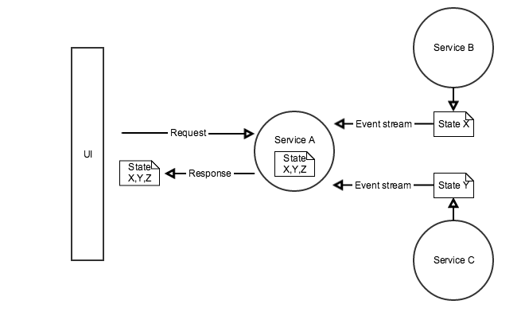
Microservice Workflow execution
Multi step process
Long running, with state, happy & non-happy
Changes in workflow definition & state structure
Each step (potentially) in different microservice
Microservices are unaware of each other
Multiple approaches
Orchestrator – running the process by invoking the required microservices subsequently, responding either to synch response, asynch callback or event
Choreography – allow the required microservices to react to relevant events
Act when it is your turn (as determined by routing slip?)
Share state through cache with claim check in routing slip
When done, publish updated routing slip
Possibly implement compensation handler
Notes:
http://www.dreweaster.com/blog/2016/05/08/the-art-of-microservices-integration-using-service-choreography/
End-to-end autonomy (each microservice leverages event sourcing to maintain the state it needs (even though it does not own it)
https://www.slideshare.net/CAinc/hypermediadriven-orchestration-in-microservices-55985377

Slide 59
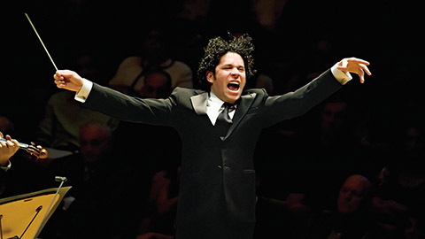

Cross Microservices Workflow
Choreography vs Orchestration – Which one is which?

Slide 60
Orchestration
Choreography
Store Web App
HTTP/JSON 200
{‘outcome’ = ‘processing’}
HTTP/JSON
Store Web App
Outcome
(Websocket, pushNot or Pull)
HTTP/JSON
HTTP/JSON 200
{‘outcome’ = ‘rejected’}
HTTP 202
Accepted
API Gateway
API Gateway
Process Engine
µService
Orchestrated Process
Receive Details
Credit Check
Process
Credit
Process
Credit
Receive Details
Check Credit Score
Good?
Yes
Reject
No
Process
Service
Event Hub
Credit Check
Process
Credit
Credit Check Event
Credit Check
Success
Credit Check
Failed

Slide 61
Conclusions regarding workflow
Orchestration allowed within domain | microservice
Not across microservices
Choreography for cross domain workflows
Relying on events
Based on routing slips?

Slide 62
How? Run & Operate

Slide 63
Run & Operate Microservices
µ
µ
µ
µ
µ
Rapid rollout
Including scale out & recover
Non breaking upgrade & rollback strategies (e.g. canary release)
Agile infrastructure
Relocate, independent of infra specifics
Health management
Monitor and safeguard SLA requirements on response time, success and availability
Scale elastically
TCO management
DevOps: one team creates and runs
Generic Infrastructure Platform for running DevOps Products

Slide 64
AMIS Bus, Dev & Ops proposities
BusOps
DevOps
Idea|Create|Prepare | Plan
Do
Bus
Dev
Ops
Application Development
AppOps
Strategie
AppOps
Applicatie
Applicatie
Functionele Requirements/ Epics & Stories
CD
Platform
Platform
Achitectuur
PlatformOps
Infra
Infra
Platform Development

Slide 65
AMIS Bus, Dev & Ops proposities
BusOps
DevOps
Idea|Create|Prepare | Plan
Do
Operationele SLA &Life Cycle afspraken
met business owner
Bus
Dev
Ops
Application Development
AppOps
Strategie
AppOps
Applicatie
Applicatie
Functionele requirements van Product Owner
Functionele Requirements/ Epics & Stories
Functionele SLA & KPIs van business applicatie eigenaar
CD
Platform
Platform
Achitectuur
PlatformOps
Non-Functionele requirements van Product Owner, Architect, Ops team
Non Functionele SLA & KPIs van applicatie beheerder
Infra
Infra
Platform Development

Slide 66
DevOps Teams
Rollen in DevOps teams:
Product Owner, Scrum Master, Architect, Platform Engineer (programmeur van infra as code), Ontwikkelaar, Tester
DevOps Team - Product X
DevOps Team - Product Y
DevOps Team - Product Z
Applicatie
Applicatie
Applicatie
Generiek Logisch Platform
Mail
IAM
Event Bus
Service Mesh
Monitoring, Logging
Billing
Notification
1e lijns helpdesk
Issue Management
CI/CD
Container Image Registry
Blueprints (eg Cloud Formation)
Base container images
Platform
Platform
Infra
Infra
Platform
λ
Generiek Platform Team
VMs
Storage
Kubernetes Cluster
Serverless Platform
Generiek Infra Platform
Cloud B
Cloud C
Cloud A
On Premises

Slide 67
The elephant in the room…
whale

Slide 68
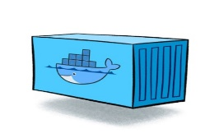
Containers
As vehicle for:
Encapsulate
Build
Share & Ship
Automated Tests
Deploy
Run
Scale
Relocate
Standardize

Slide 69
Looking for a runtime platform for
Compute Node
Notes:
Deploy and Run (Docker Containers)
Distributed infrastructure (scalable and available)
Hide infrastructure from DevOps teams
Auto-healing
Elastic Scale
Wire up the micros – connect dynamically (service discovery)
Load Balance
Provide Persistent storage
Rolling Upgrade
Configuration & Secret Management
Secure

Slide 70
Looking for a runtime platform for
Compute Node
Compute Node
Compute Node
Notes:
Deploy and Run (Docker Containers)
Distributed infrastructure (scalable and available)
Hide infrastructure from DevOps teams
Auto-healing
Elastic Scale
Wire up the micros – connect dynamically (service discovery)
Load Balance
Provide Persistent storage
Rolling Upgrade
Configuration & Secret Management
Secure

Slide 71
Looking for a runtime platform for
Compute Node
Compute Node
Compute Node
Notes:
Deploy and Run (Docker Containers)
Distributed infrastructure (scalable and available)
Hide infrastructure from DevOps teams
Auto-healing
Elastic Scale
Wire up the micros – connect dynamically (service discovery)
Load Balance
Provide Persistent storage
Rolling Upgrade
Configuration & Secret Management
Secure

Slide 72
Looking for a runtime platform for
Compute Node
Compute Node
Compute Node

Slide 73
Looking for a runtime platform for
Compute Node
Compute Node
Compute Node

Slide 74
Looking for a runtime platform for
Compute Node
Compute Node
Compute Node
Cloud Storage
SAN

Slide 75
Looking for a runtime platform for
Configuration Map
Configuration Map
Compute Node
Compute Node
Compute Node
Cloud Storage
SAN

Slide 76

Looking for a runtime platform for
Compute Node
Compute Node
Compute Node

Slide 77
Looking for a runtime platform for
Compute Node
Compute Node
Compute Node
Compute Node
Compute Node

Slide 78
Looking for a runtime platform for
Compute Node
Compute Node
Compute Node

Slide 79
Looking for a runtime platform for
v2
v2
v2
Compute Node
v2
v2
Compute Node
Compute Node

Slide 80
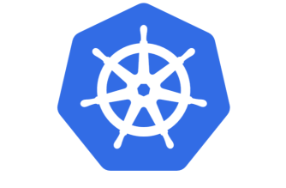

Slide 81
Introducing Kubernetes
Distributed Container Run Time Management platform
Based on Google’s Borg system (in use at Google for over a decade)
Initial announcement: 2014
Kubernetes v1.0 was released on July 21, 2015
A Kubernetes cluster typically spans multiple compute nodes
Either in the cloud, on premises, on a single machine (minikube) or hybrid
K8S manages Pods in which containers are running
K8S schedules Pods on one or more nodes
Docker can be the container runtime; other engines are supported as well, such as rkt and containerd
K8S handles network traffic to, between and from Pods
The kubectl command line interface is used for most management activities

Slide 82
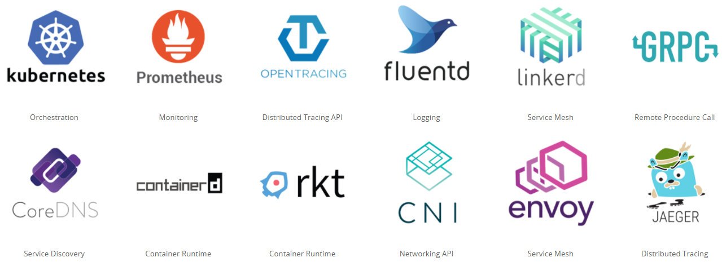
Cloud Native & Vendor Neutral
Cloud Native Computing Foundation - CNCF
Oracle is a platinum member since July 2017
Cloud Native: container packaged, dynamically managed, microservices oriented
Open technology for running container based workloads in a cross cloud vendor neutral way
Notes:
https://www.cncf.io/

Slide 83
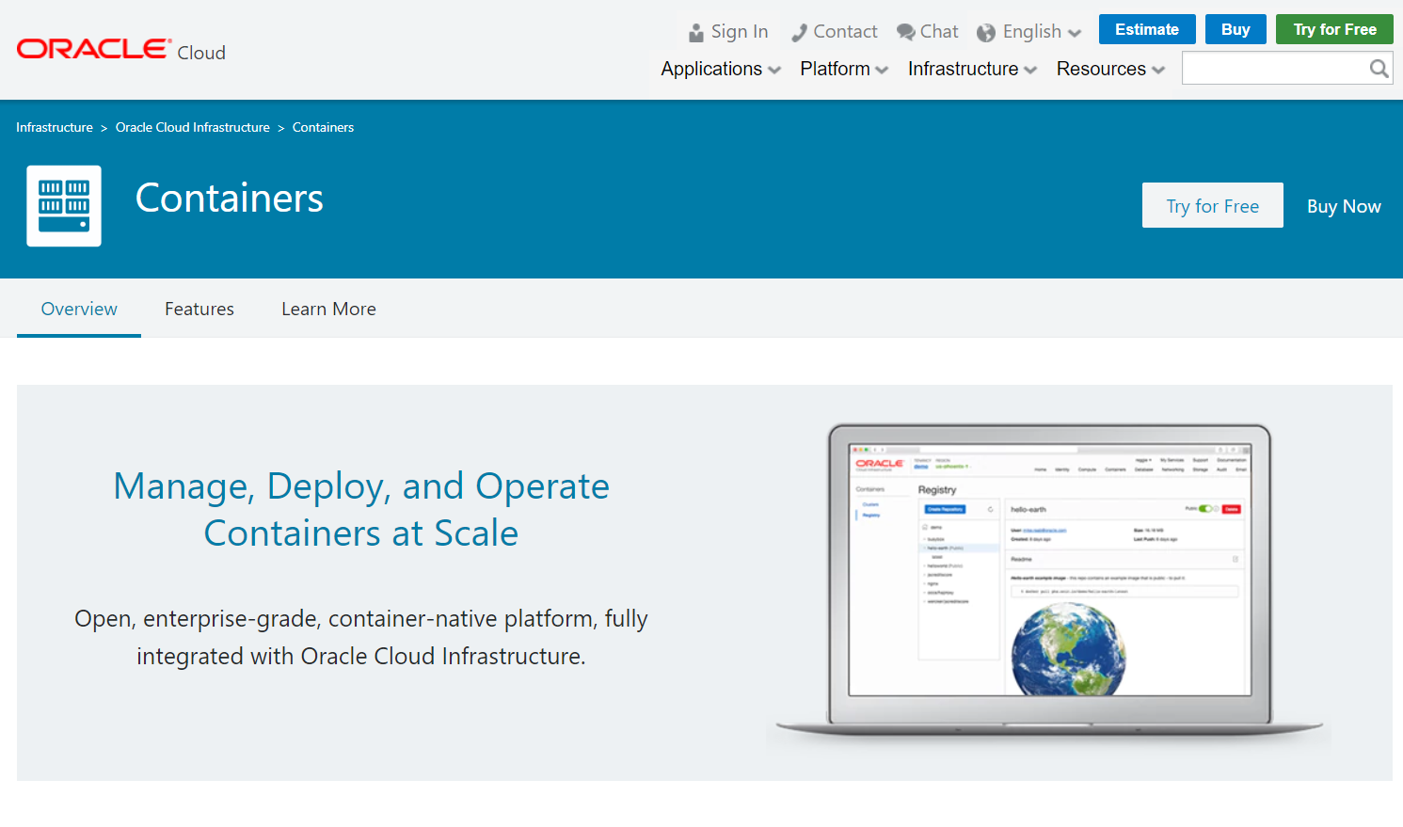

Slide 84
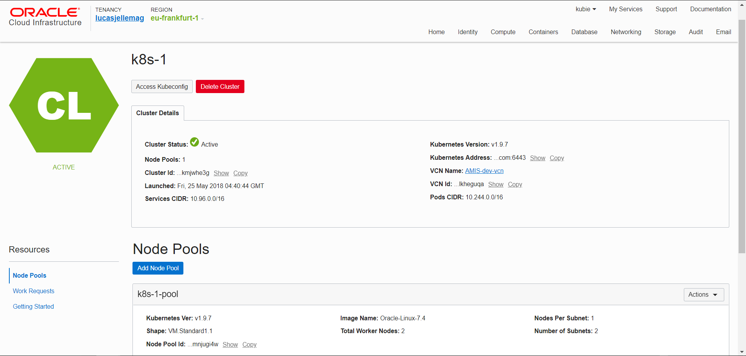

Slide 85
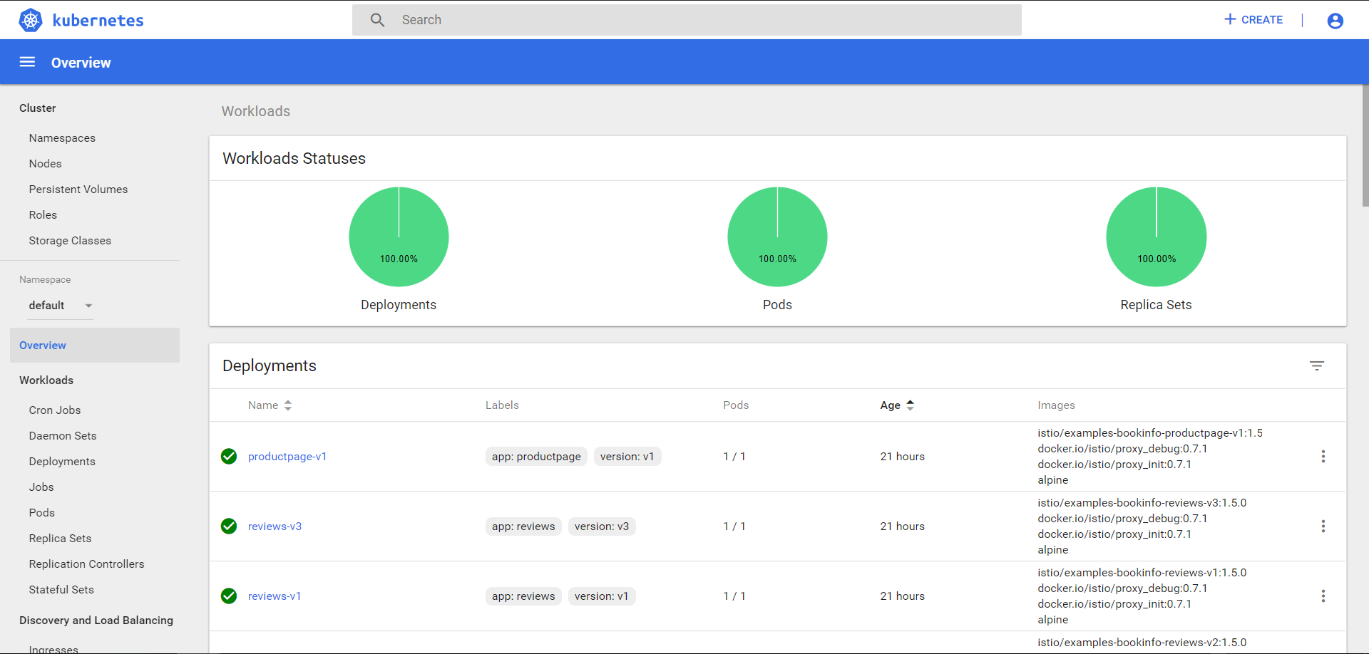

Slide 86
Kubernetes & OKE Demo

Slide 87
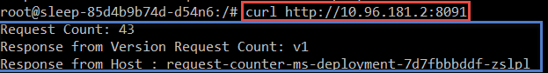
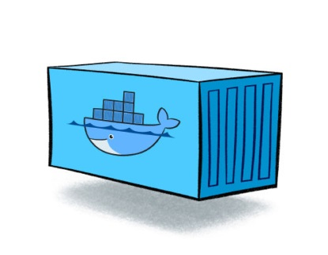
RequestCounter Microservice – V1
/
/health
/ready
/kill
http GET
RequestCounter
counter
Compute Node
Compute Node
Notes:
RequestCounter on K8S
Deployment with two replicas
Readiness Probe, Liveness probe
Kill-switch – special request that can disable liveness
Steps
Apply deployment with kubectl
Show in dashboard /cli two pods are started
Demo calls: load balanced, no shared state
Kill one – continue to make calls (no longer load balanced)
A second pod is started (because of liveness was broken)
Scale deployment to three – show that three pods are running
Upgrade to v2 – using Redis for shared state
Now kill all three (three rapid kill calls); new instances – proceed from same state

Slide 88
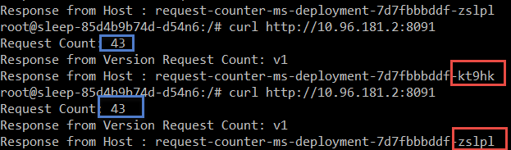
RequestCounter Microservice – V1
/
/health
/ready
/kill
http GET
RequestCounter
counter
counter
Compute Node
Compute Node

Slide 89
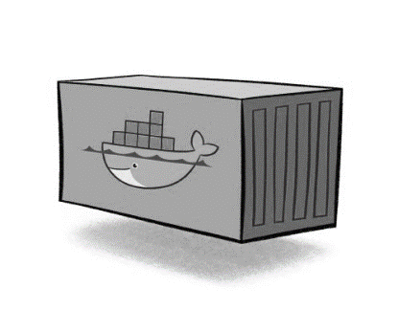
RequestCounter Microservice – V1
/
/health
/ready
/kill
http GET
RequestCounter
counter
counter
counter
counter=0
Compute Node
Compute Node

Slide 90
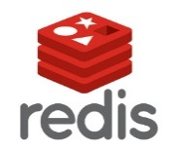
RequestCounter Microservice – V2
/
/health
/ready
/kill
http GET
RequestCounter v2
counter
Compute Node
Cache
Compute Node

Slide 91
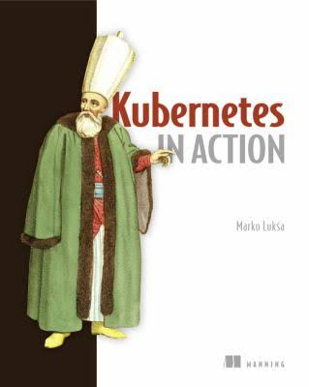

Slide 92
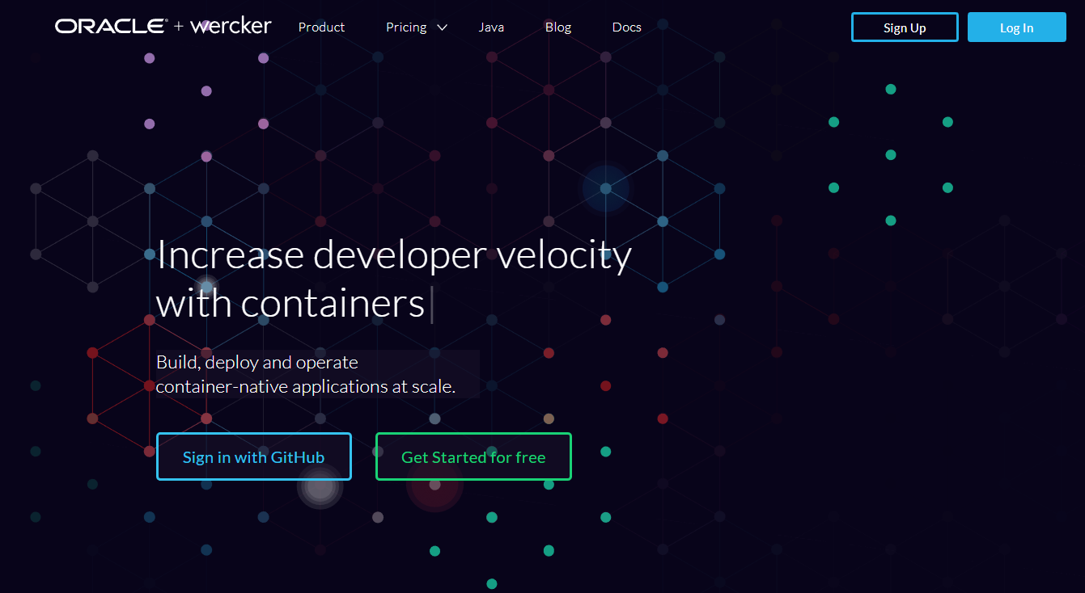
Automated Container [Build | Stock | Deliver] Pipelines
Oracle Wercker

Slide 93
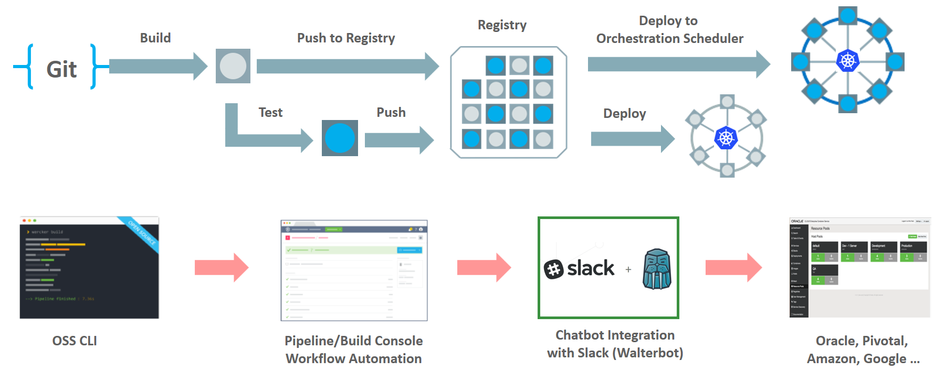
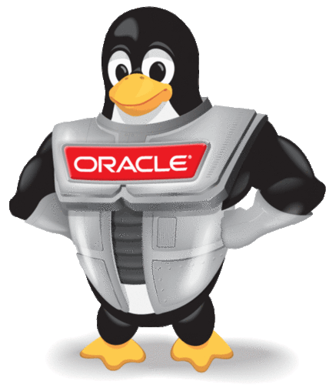
Wercker: Build, Test, Push and Deploy Pipelines for Containers
µ
µ
µ

Slide 94
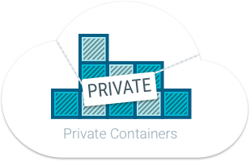
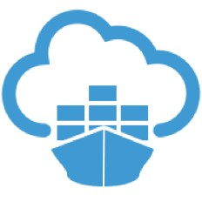

Oracle Container Registry for Your Images
After build and before run – container images need to be stored
Secure (because runtime artefacts)
Accessible (& low latency) to deployment engine and container runtime
Scalable and Smart (no duplicate images and image layers)
Notes:
https://docs.us-phoenix-1.oraclecloud.com/Content/Registry/Concepts/registryoverview.htm?Highlight=registry

Slide 95
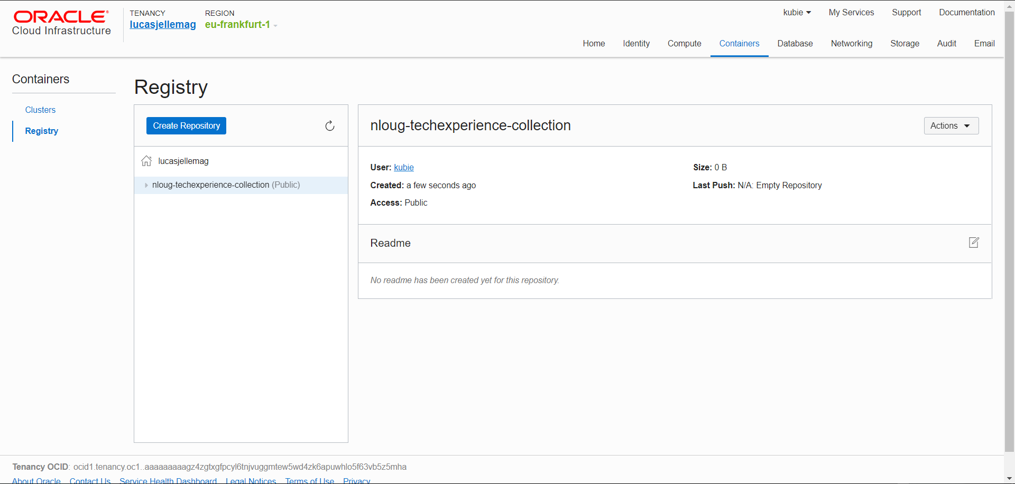

Slide 96
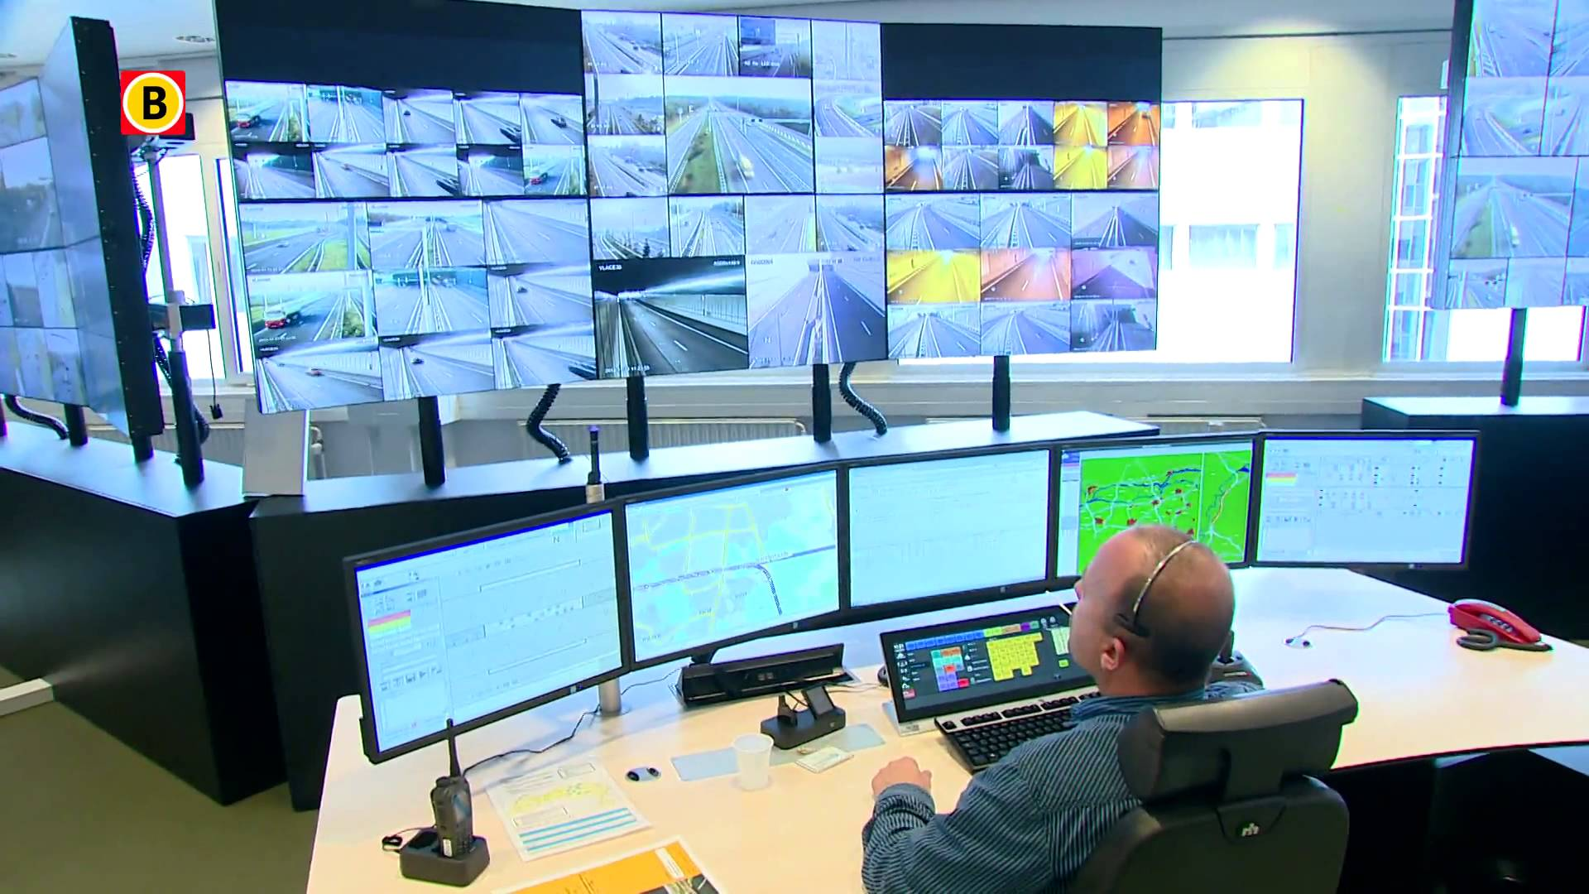

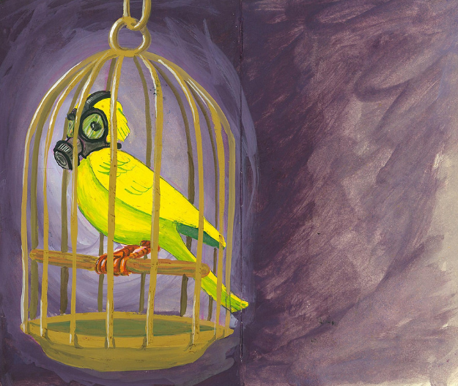
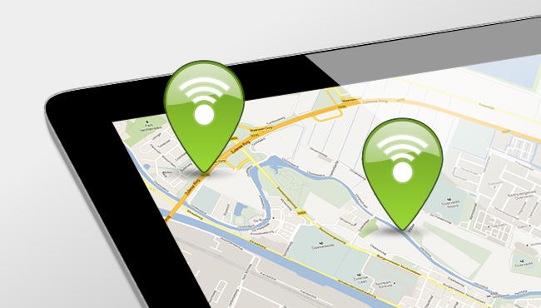
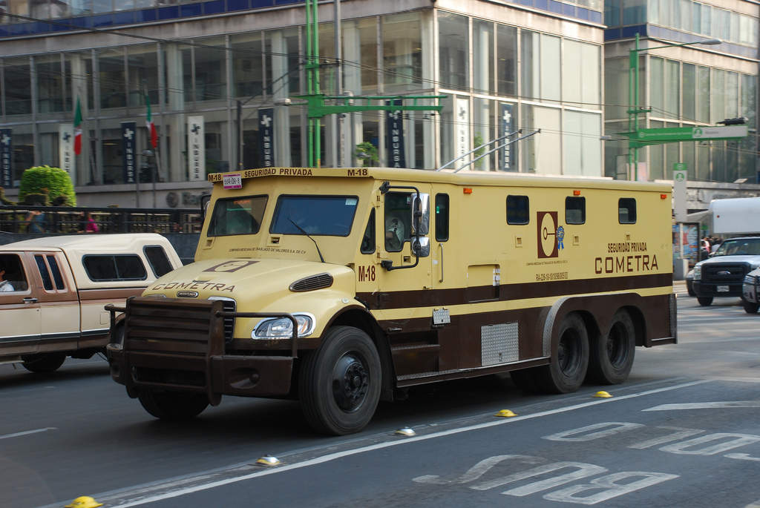


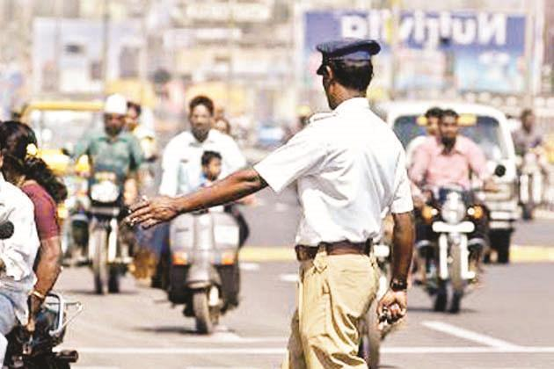
Microservice Runtime Platform - plus
Notes:
Monitor
Health
Load/performance
Tracing
Collect metrics & logs for analysis
Route
A/B, Canary, Authorize/Policy Enforcement, Protocols
Circuit Breaker, Throttle (Rate Limiting)
Mirror traffic for asynchronous testing
Security
TLS
Access control – whitelist/blacklist,

Slide 97


Slide 98








Istio – Service Mesh Operations
Routing
Access Control
Whitelist/Blacklist
Security
TLS
Resilience
Rate Limiting & Circuit Breaker
Monitoring
Trace
Service Graph

Slide 99
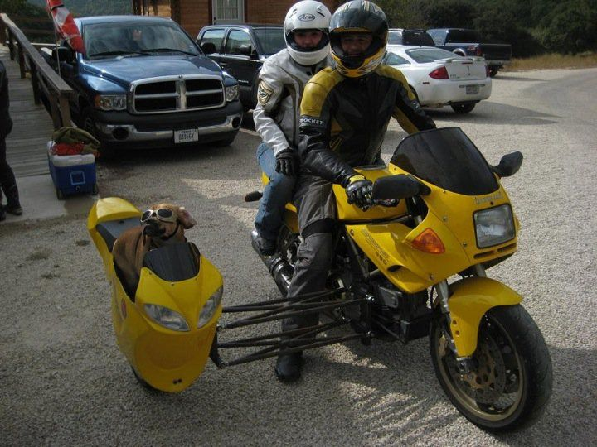
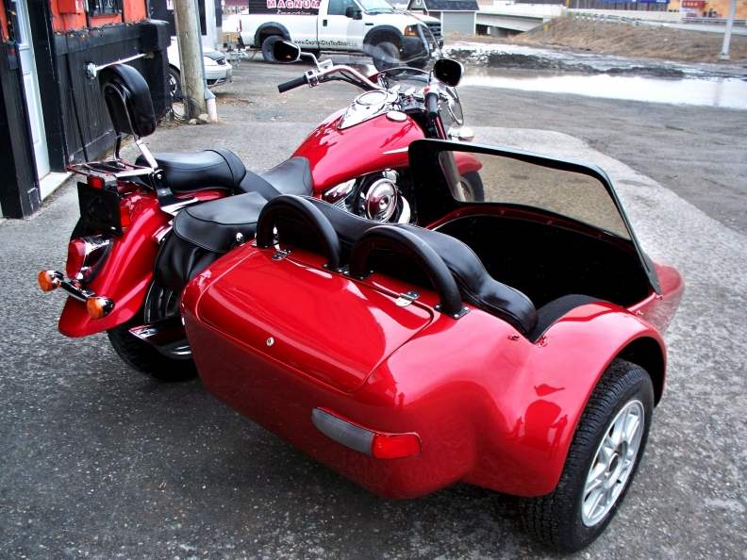

Slide 100
Envoy Sidecar
http(s), tcp,gRPC
Pod
Envoy Sidecar
Metrics, trace, policy checks
Istio Mixer
Configuration
Istio Pilot
TLS Certificates
Istio Auth
Notes:
Docker container
Injected into Pod
Handles all inbound/outbound traffic
Guided by Pilot
Reporting to Mixer

Slide 101

Serverless
λ
λ
λ
λ
λ
λ
λ
λ
λ
λ
λ
µ

Slide 102


Open Source Serverless Function Platform
Functions can be implemented in any language
Java, Go, PHP, JavaScript/Node, Python, Ruby
Functions run in their own container
Functions can be accessed via HTTP calls
Routing, load balancing, running is taken care of by Fn Server platform
Platform runs locally, on prem & in cloud
Fn Flow orchestrates workflows across multiple functions
Workflow described in Java
Includes business logic (conditional, parallel execution, exceptions)
µ
Notes:
https://blogs.oracle.com/developers/kubecon-europe-2018-oracle-open-serverless-standards-fn-project-and-kubernetes

Slide 103


Project Fn has announced support for
Notes:
https://cloudevents.io/
https://serverless.com/

Slide 104

Managed Serverless Platform on Oracle Public Cloud
λ
µ

Slide 105












Microservices Platform (Kubernetes & Istio) ++
API Gateway
Cache
Event Hub
Service Broker
Chaos Monkey & Regression Testing
Workflow
Transactions (cross microservice)
RDBMS, NoSQL, Data Lake(Big Data), Fast Data Ingestion
Billing
Notification
Microservices Platform
Storage

Slide 106



Oracle Container Native Microservices Architecture
µ
λ
Foo2
Voice Recognition
API Registry
Event Management
Open Service Broker
Billing Engine
ISTIO
Diagnostics/Monitoring
Prometheus
Developer Cloud
ISTIO
ISTIO
Managed Kubernetes
Block Storage
Cache
RDBMS
LDAP/IdM
NoSQL

Slide 107





Thank you Dank je wel
Blog: technology.amis.nl
Email: lucas.jellema@amis.nl
: @lucasjellema
: lucas-jellema
: www.amis.nl, info@amis.nl

